Slide 1
WELCOME
Presented By:
Muhammad Nazrul Islam
Junior Instructor(RTV), Jamalpur TSC.

Slide 2
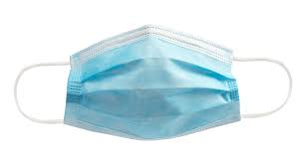

Slide 3
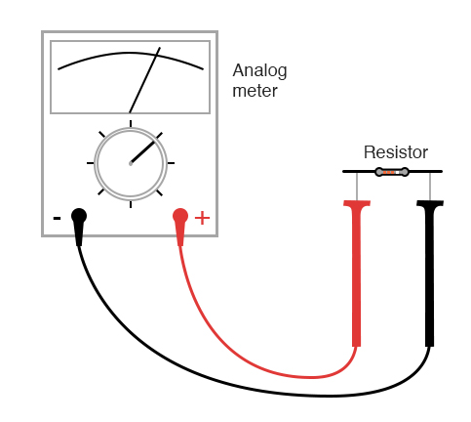
Review Previous Session :
Measure Electrical Quantities
What is Resistance ?
What is the full meaning of AVO ?

Slide 4
Outcome of this Session
At the end of the session, learners will be able to
Test Transistor Using AVO meter according to industry standard within 15 minutes.

Slide 5
Structure
Discussion
Demonstration (4 Steps)
Feedback
Next Session

Slide 6
Stimulation
Success Story

Slide 7
PPE

Slide 8
Required Tools Equipment and Materials:
Sl. No. | Tools and Equipment | Quantity
1 | AVO meter | 1 piece
2 | Nose Plier | 1 piece
Sl. No. | Raw Materials | Quantity
1 | Transistor (D400, A1015) | 2 pieces

Slide 9
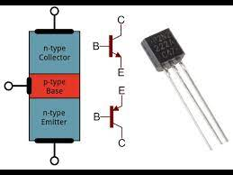
Transistor
A transistor is a semiconductor device used to amplify or switch electronic signals and electrical power. Transistor is a active component. It has three Terminals.
Transistor

Slide 10
Procedure
Wear Appropriate PPE for the job.
Follow OSH.
Read provided JOB sheet and Specification sheet
Collect Tools, Equipment and Materials as per specification sheet
Prepare Tools, Equipment and Materials to do the job.
Connect Transistor according to testing instruction.

Slide 11
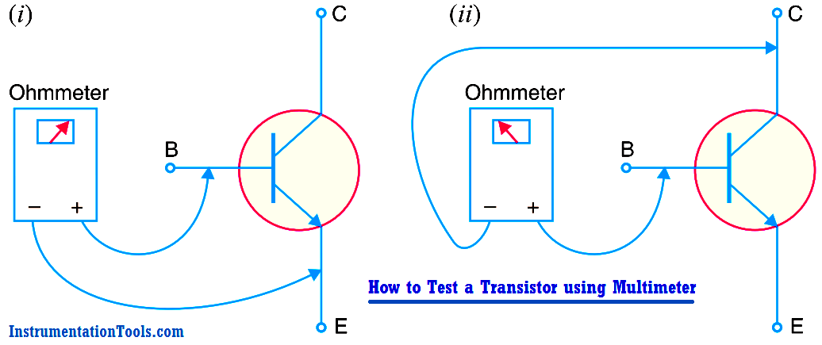
Procedure
Test and check.as per set standards.
Identify Transistor terminals.
Submit Required evidence to the assessor.
Restore Tools, Equipment and Materials.
Clean the workplace.

Slide 12
Demonstration
Wear PPE
Take job sheet and specification sheet
Take tools, equipment and materials.

Slide 13
Review and Feed Back
What we learned from this session:
How to test a Transistor ?
How many terminals does a transistor have? What are the terminals?

Slide 14
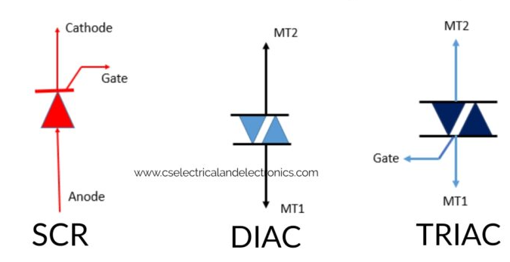
Next Session
Test SCR, DIAC, TRIAC using AVO meter
CBLM, Page-30

